Slide 1
The secret sauce of Specialist Volunteering
Managed and funded by Inspiring Scotland but open to all Scottish third sector organisations
Reactive to ever-changing demand in the sector - regular mapping of the 700+ charities in our portfolios
Great way to foster collaboration with the private sector and the third sector - raising awareness of social issues and create lasting change
Free expert advice saves charities money but the softer outcomes of building sustainability, resilience and moving organisations forwards is invaluable
Long-standing record of tailored support for the third sector making the SVN unique by size, effectiveness and reach
Ability to inform and influence thinking around the growth of professional pro bono through membership of the UK and global pro bono organisations

Slide 2
Our #ChangeMakers
Our #Changemakers
Breakdown of Support
Over 3000 hours volunteered last year
Over £650K of support delivered pro-bono
Average of 29 requests a month (excluding SVN workshops)
42 active Trustee recruited from SVN

Slide 3
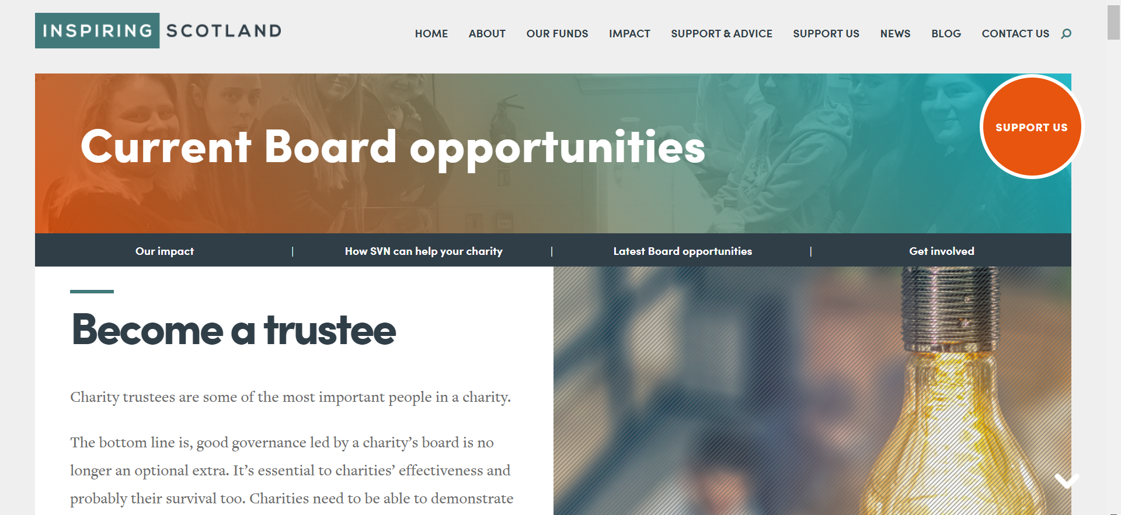
SVN | Trusteeship and Governance
50+
organisations received bespoke training last year
Visit our webpage HERE!

