Slide 1
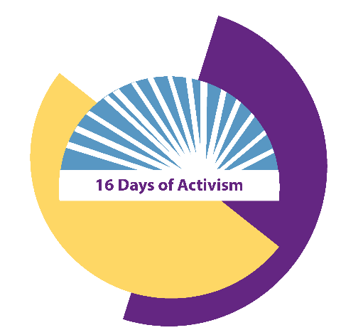
Imagine a Scotland without
gender-based violence
Type your idea here
#16Days

